Slide 1

Spotify API Testing
Uzair, Eric and Ramone

Slide 2

What is the Spotify API?
The Spotify API, allows developers to integrate Spotify’s features into an application via the JSON metadata returned when a request is made. These features include (But are not limited to):
Retrieve an Artist’s Spotify
Retrieve the User’s artists and playlists they they’re following
Follow/Unfollowing a User/Artist

Slide 3
What we tested
Services we tested:
Follow Artist/User Service
Get Albums Service
Get Artist/User Service
Get Following Artist Service
Unfollow Artist/User Service
We tested for:
Valid inputs
Invalid inputs
No inputs

Slide 4
Why we tested
The requests were simple to test
A user would be ok with these requests being made from external applications
We lacked experience with API testing, so we chose the requests that were easy enough for us to complete
We lacked experience with working collaboratively using Git hub

Slide 5
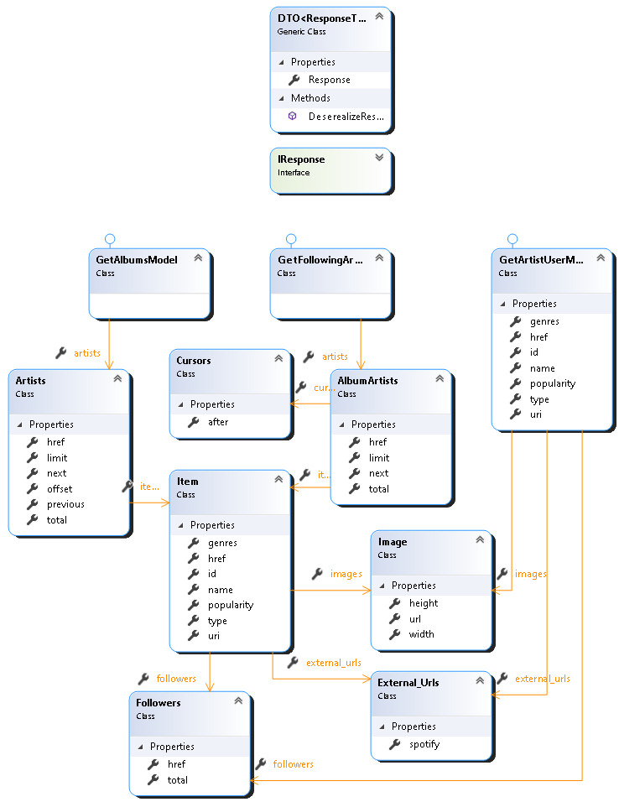
Model Class Diagram

Slide 6
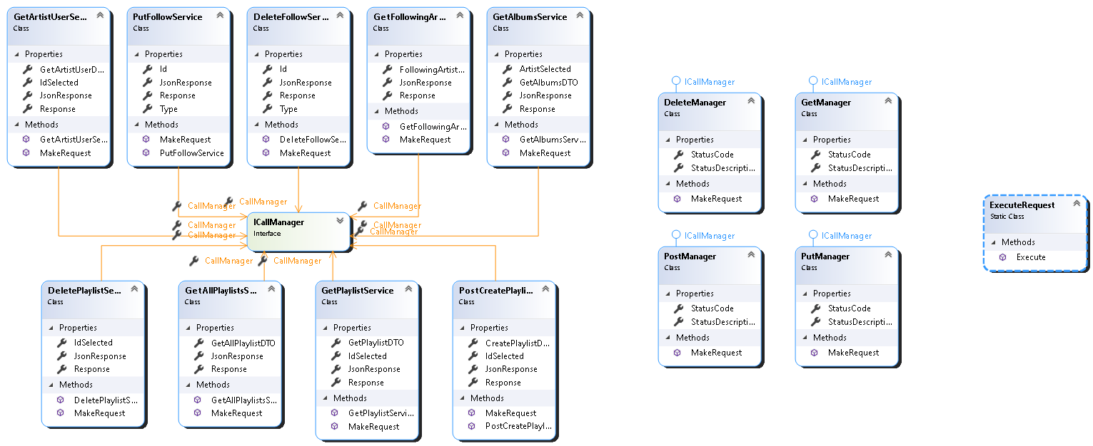
Service Class Diagram
- How we did the service model - How we made the request - Diagram, services models linked tot the call manager

Slide 7
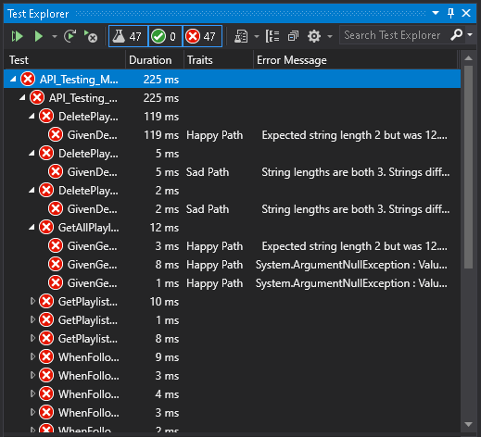
Testing snippets

Slide 8
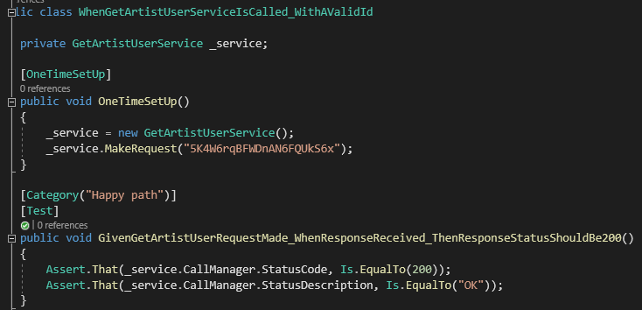
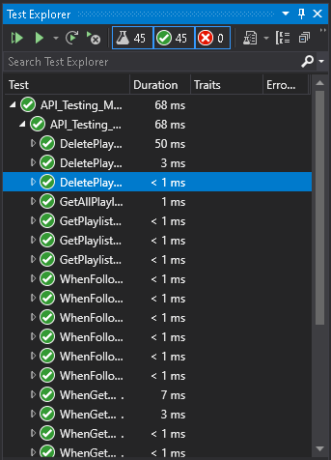
Testing snippets

Slide 9
Retrospective – What went well
We worked on different parts of the application to ensure no merging issues
We wrote our acceptance criteria in Gherkin syntax which made writing test cases easy
We played around with requests on postman, so we had a good understanding of their behavior
Refactoring code to make it easier for other users to extend its functionality
We had different branches with specific restrictions to make sure the code was approved by other members of the team before merging

Slide 10
Retrospective - Problems we faced
Finding the right API with enough endpoints
We had problems getting the status code from requests which we resolved by casting enums to ints
We has problems with requests that did not return a JSON string, we resolved this by using a try catch block
Access token expired frequently giving us incorrect error messages during our testing, making finding the why the test(s) failed difficult

Slide 11
Retrospective – Next time
Make less frequent pull requests because they are time consuming, and most pull requests were unnecessary
We can test more requests because of our experience through this project
For minor issues we’ll fix the issue on one machine rather than getting the person responsible for the file to fix the mistake and make a pull request

